Slide 1

INTRO TO
PYTHON
Section Two

Slide 2
Accepting input from the users
The input() function always returns the user's input as a string, regardless of the input type. If you need to process the input as a different data type (e.g., integer or float), you need to explicitly convert it using appropriate typecasting functions like int() or float().
age = input(“How old are you?”)

Slide 3

Activity 1
Write a program to convert Celsius to Fahrenheit

Slide 4
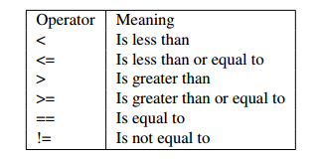
Relational Operators
relational operators are used to compare values and determine the relationship between them. These operators return a Boolean value (True or False) based on the comparison result. Here are the relational operators in Python:

Slide 5
Accepting input from the users
The input() function always returns the user's input as a string, regardless of the input type. If you need to process the input as a different data type (e.g., integer or float), you need to explicitly convert it using appropriate typecasting functions like int() or float().
age = input(“How old are you?”)

Slide 6
Logical Operators
Logical operators are used to combine and manipulate Boolean values. They allow you to perform logical operations on one or more Boolean expressions and evaluate the overall result.
Python provides three logical operators:
AND, OR, NOT

Slide 7
Logical Operators cont.….
Logical AND :The and operator returns True if both operands are True, and False otherwise. It evaluates the second operand only if the first operand is True.
Logical OR :The or operator returns True if at least one of the operands is True, and False if both operands are False. It evaluates the second operand only if the first operand is False.
Logical NOT : The not operator returns the opposite Boolean value of the operand. It negates the truth value.

Slide 8
Conditional Statements
Conditional statements in Python are used to control the flow of a program based on certain conditions. Python provides three main conditional statements:
if, elif (short for "else if"), and else. These statements allow you to execute different blocks of code depending on the outcome of specified conditions.

Slide 9
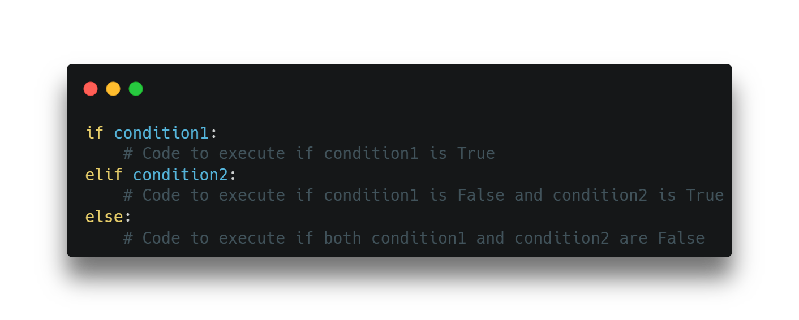
Conditional Statements cont…
Pay close attention to the syntax of conditional statements.

Slide 10
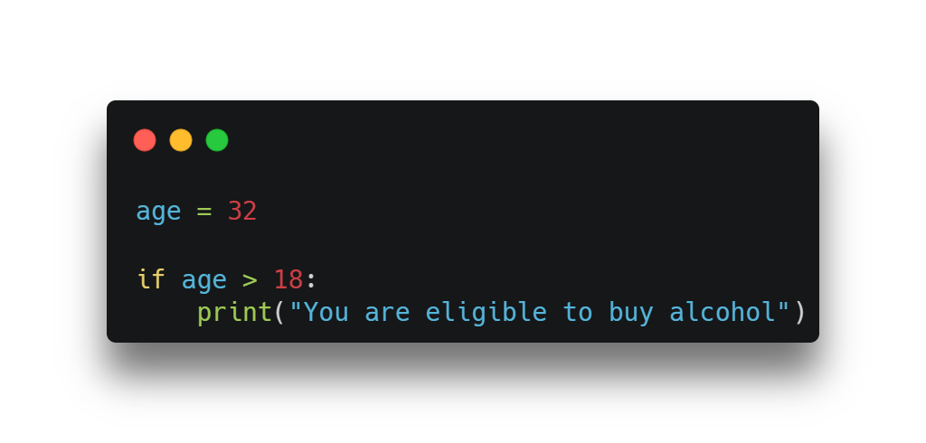
Example

Slide 11
Activity 2
Fix the above example so that it will replay “your are not eligible to buy alcohol” if the customer age is under 18.

Slide 12
Example
1.Check if a Number is Positive, Negative or 0 Using if...elif...else
num = input("Enter a number: ")
if num > 0:
print "Positive number"
elif num == 0:
print "Zero"
else:
print "Negative number"

Slide 13
Activity 3
Write a Python program to check if the input number is odd or even.

Slide 14
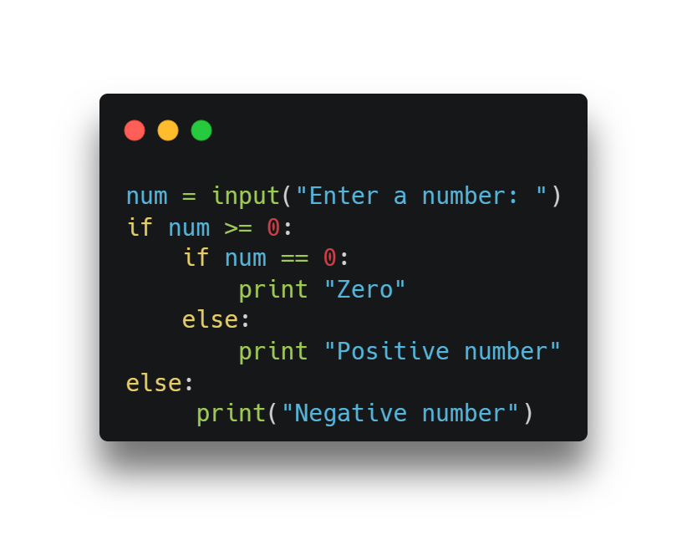
Nested conditionals
Nested conditionals in Python refer to the situation where one conditional statement is nested within another conditional statement. This allows for more complex decision-making logic in your code. Here's an example of nested conditionals:

